Slide 1
How does The web works?
First, What is the web ?
• The Web is a part of internet, it is a collection of web pages located in a network of computers and is accessed using a web browser.
How does it work ?
• The Web contains web pages that are in HTML, that are stored on a web server which is a special computer that store, process and deliver web pages to users.
It seems like a simple question but does everyone really knows how?
• To display webpages you will need a web browser, but to view particular webistes you need to type its URL into it.

Slide 2
What DO YOU NEED TO BE A web DEVELOPER?
Web development is the building and maintenance of websites and to become a web developer you need to learn various skills and programming languages depending on what you specialize, in which is divided into 3 types.
1
2
3
FRONT-END developers
BACK-END developers
FULL-stack developers
The Front-end of a website is everything the user either sees or interacts with when they visit the website. It is responsible for the total look and feel of an online experience.
Back-end refers to the server-side development. It's work that happens behind the scenes which the user can't see but uses without knowing.
A Full-stack web developer is a person who can develop both client and server software. In other words he does Front and Back developement

Slide 3
What is the role of a web developer?
TO Create websites and web applications
TO KNOW HOW TO COMMUNICATE AND WORK WITH A TEAM
TO Be efficient and PATIENT
TO BE PASSIONATE AND MOTIVATED
TO KNOW HOW TO DO RESEARCHES
TO BE CONSTANTLY learning

Slide 4
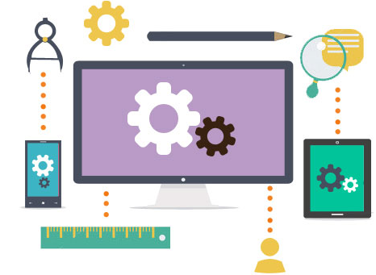
IN CONCLUSION …
Web development is a vast and interesting field which makes the learning phase more exciting.
It requires a lot of motivation, patience and passion but it's very rewarding at the end.

